Slide 1

Welcome

Slide 2
Agenda
Welcome
Presentation of options
Have your say
Next steps
Thank you

Slide 3



Our plans for the future

Slide 4
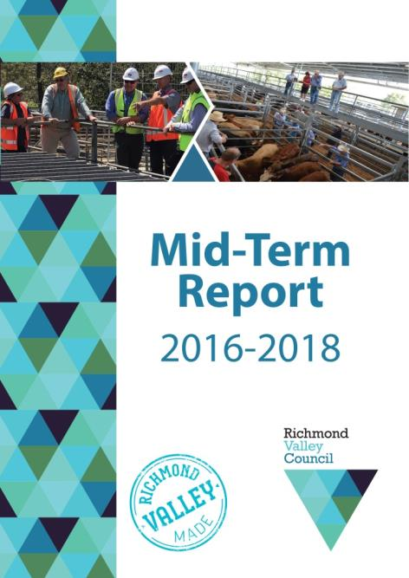

Our progress reports

Slide 5
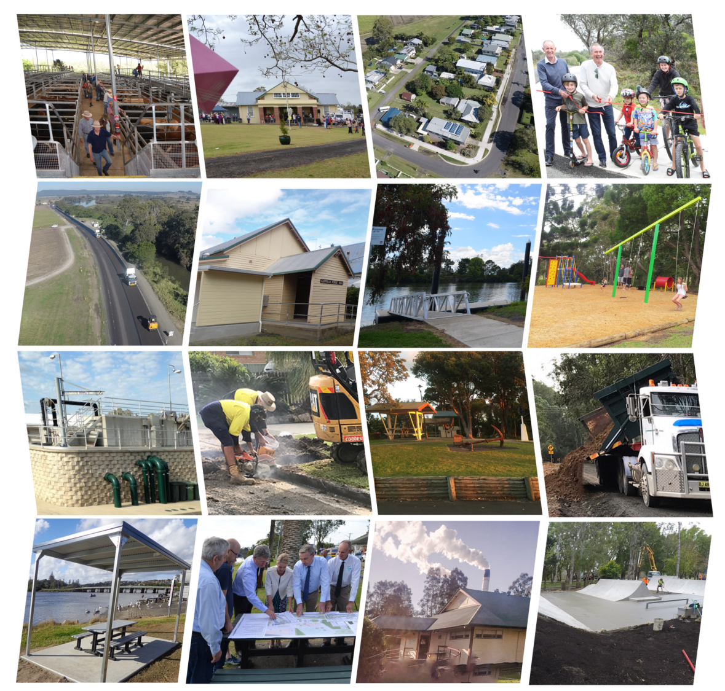
Community projects

Slide 6
SCCF – government grants
Round 1 Stronger Country Community Fund (awarded in early 2018) yielded five successfully funded projects for Richmond Valley Council:
$101,990 to complete the fitout of the clubhouse for Evans Head Tennis Clubhouse
$267,833 for a modern catering and amenities block at Casino Showground
$201,926 for 'Fit for Parks' - outdoor gyms for Crawford Square, Casino, and Evans Head riverside
$152,028 for stage one for the revitalisation of Casino Civic Hall
$131,785 to upgrade the Broadwater outdoor youth space and park
  Total: $855,562

Slide 7
SCCF – government grants
Round 2 Stronger Country Community Fund (awarded in late 2018) saw six successfully funded projects for Richmond Valley Council:
$551,776 for Woodburn Riverside Park playground and central hub Area
$309,884 for Stan Payne Oval sporting facility enhancement with grandstand upgrade and security bollards
$185,765 for Evans Head Main Beach access enhancement
$479,717 for Queen Elizabeth Park sporting complex enhancement
$95,053 for Coraki Hockey Club training facilities – Windsor Park revitalisation
$98,714 for Woodburn Recreation Oval enhancement of sporting facilities
  Total: $1,720,909

Slide 8
Where does our rates revenue come from?
Total annual revenue in 2018/19 is $55.5 million
Total rates revenue in 2018/19 is $12.4 million
  Casino & surrounds 60%
  Evans Head & surrounds 20%
  Other towns/villages and rural areas 20%

Slide 9
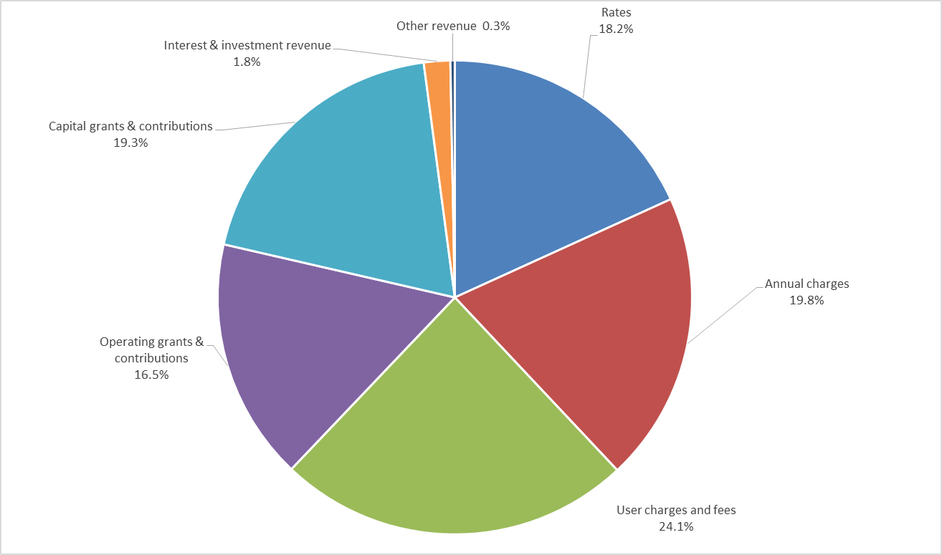
Council revenue sources

Slide 10
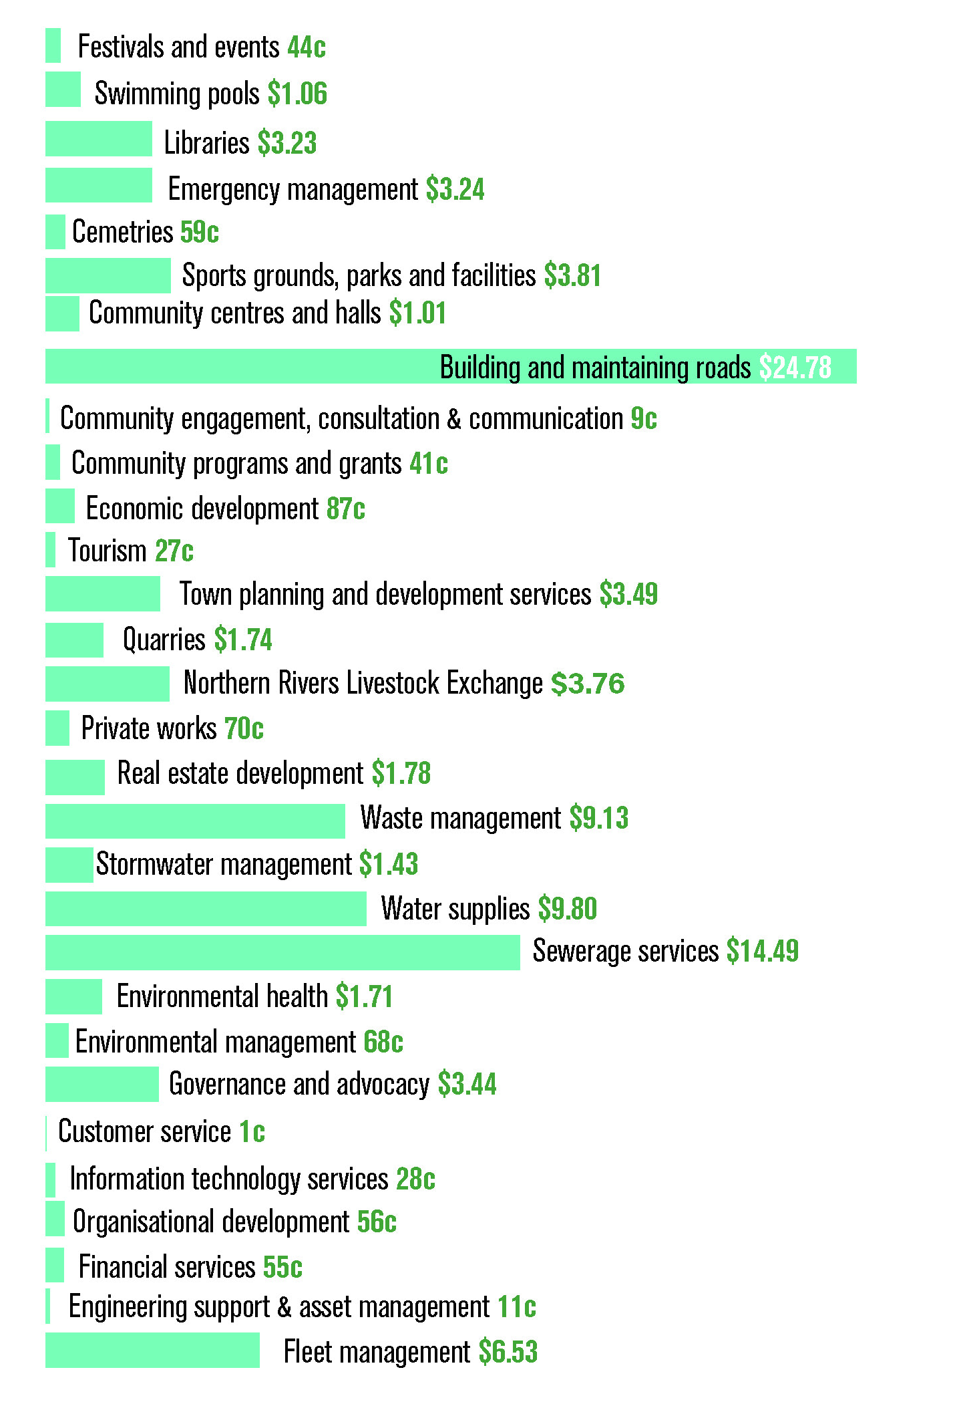
Council spending per $100

Slide 11
2014/15 – 2018/19 5 year SRV highlights
In total it generated $7.8 million (including rate peg) and rates increased over a five-year period by 37%
An extra $5.534 million spent on our road network
An extra $760,000 spent on infrastructure in our parks and gardens
$745,000 spent on additional services
An extra $3.685 million spent on new capital projects

Slide 12
2014-15/2018-19 SRV projects
Expenditure includes all CSP projects plus maintenance increases and organisation capacity | TOTAL Expenditure
RENEWALS
Sealed road rehabilitation | $5,000,000
Gravel road re-sheeting | $534,988
Playground replacement - replace non complying equipment and replace softfall | $60,000
Public toilet refurbishment | $200,000
Renewal Council facilities and parks. | $500,000
TOTAL RENEWALS (LOAN FUNDED) | $6,294,988
ADDITIONAL SERVICE
Casino riverbank presentation | $250,000
Sealing of unsealed urban roads | $375,000
Cultural and art facilities. | $120,000
TOTAL ADDITIONAL SERVICE | $745,000

Slide 13
2014-15/2018-19 SRV projects
Expenditure includes all CSP projects plus maintenance increases and organisation capacity | TOTAL Expenditure
CAPITAL IMPROVEMENTS
Casino Drill Hall and riverfront amphitheatre project | $1,050,000
Evans Head public amenities upgrades 2018/19 | $470,000
Woodburn riverside park upgrade | $500,000
Coraki riverfront upgrade | $355,000
Casino Showground upgrades | $100,000
Casino car parking | $580,000
Evans Head skatepark | $100,000
Crawford Square regional park | $150,000
Woodburn skatepark | $80,000
Casino skatepark | $240,000
Town entrance signage | $60,000
TOTAL CAPITAL IMPROVEMENTS | $3,685,000

Slide 14
2014-15/2018-19 SRV projects
Expenditure includes all CSP projects plus maintenance increases and organisation capacity | TOTAL Expenditure
IMPROVED MAINTENANCE
Playground maintenance | $75,000
Toilet cleaning maintenance | $75,000
Rural road drain maintenance | $250,000
TOTAL IMPROVED MAINTENANCE | $400,000
INCREASED CAPACITY
IT innovation fund. | $200,000
Public wifi in Casino, Woodburn, Evans Head CBDs and Coraki Riverfront | $150,000
Economic development plans/projects to support growth | $165,000
TOTAL INCREASED CAPACITY | $515,000

Slide 15
How does Richmond Valley Council compare to other Northern Rivers councils?

Slide 16
Northern Rivers Councils Comparisons

Slide 17
Northern Rivers Councils Comparison

Slide 18
Northern Rivers Councils Comparison

Slide 19
What is the rate peg?
Rate peg 2019-2020
IPART has set the 2019-20 rate peg for NSW councils at 2.7%. It has calculated the rate peg for 2019-20 by:
taking the increase in the Local Government Cost Index to June 2018 of 2.7%; and
setting the productivity factor to 0.0%.
The rate peg is the maximum percentage amount by which a council may increase its general income for the year without going through the Special Variation process.
How the rate peg affects individual rates
The rate peg applies to general income in total, and not to individual ratepayers’ rates. As long as its general income remains within the set maximum increase, councils may increase categories of rates by higher or lower than the rate peg.
Individual rates are also affected by other factors, such as land valuations which can affect percentage changes to rates alongside the rate pegging process.

Slide 20
Why we need another SRV
Dispersed population and rates income of $12.4 million, which is 21.76% of expenditure
Government operating grants not keeping pace with expenditure needs
Funding increasing asset renewal and depreciation expenses
Combined rates and annual charges make up less than half of Council’s revenue
 | Benchmark | 2016 | 2017 | 2018 | Meets Benchmark
Operating Performance Ratio | > or = 0% | 0% | 8% | -7% | ×
Own Source Revenue Ratio | > or = 60% | 70% | 68% | 64% | ✓
Building and Infrastructure Renewals Ratio | > or = 100% | 99% | 83% | 86% | ×
Asset Maintenance Ratio | > or = 100% | 109% | 114% | 119% | ✓
Infrastructure Backlog Ratio | < 2% | 1.30% | 3.80% | 1.90% | ✓

Slide 21
Indicative annual impact 2019-2021

Slide 22
Indicative annual impact 2021-2023
*A3 handout covering all four years provided to attendees

Slide 23
Cumulative totals
2019-2020 to 2022-2023

Slide 24
How will the SRV be spent?
Roadwork and renewal of urban streets
Grading unsealed local roads to meet existing service levels
Additional maintenance of the rural road network: bitumen maintenance; drainage; patching; roadside slashing; gravel maintenance; and vegetation management
Increased funding to maintain existing services across Council operations including emergency services
Additional bitumen resealing and gravel re-sheeting to keep our roads at a good standard and prevent them from deteriorating
Culverts, causeways, drainage and footpath renewal
Community assets renewal

Slide 25
Community consultation
Community newsletter distributed to 9478 homes and businesses, and published to Facebook. Reminder in second community newsletter issued just prior to Christmas
Micromex telephone survey
Face-to-face survey
Online survey
Request for submissions – have your say
Proposal discussed regularly on local radio COW FM and Radio 88.9
Newspaper articles and advertisements – RREE, NS, Heartland Magazine
Television interviews – Prime7, NBN
Standalone website page
Facebook posts

Slide 26
What happens next?
6 February - submissions to RVC close midday
7 February - extraordinary Council meeting
11 February - application due to IPART
11 February – IPART public submission period opens; closing 11 March
14 May – IPART’s determination released
June Council meeting– Council resolves 2019/20 budget

Slide 27
IPART contact details
Independent Pricing and Regulatory Tribunal of NSW
https://www.ipart.nsw.gov.au/Home/Industries/Local-Government/For-Councils/Apply-for-a-special-variation-or-minimum-rate-increase
Stakeholders can also provide a submission by email from 11 February 2019 at localgovernment@ipart.nsw.gov.au or by post to:
Local Government Team
Independent Pricing and Regulatory Tribunal of NSW
PO Box K35
Haymarket Post Shop, NSW 1240
Any enquiries regarding special variation or minimum rate applications should be directed to John Madden by email to John_Madden@ipart.nsw.gov.au or by phone on (02) 9113 7780. For administrative enquiries contact localgovernment@ipart.nsw.gov.au.

Slide 28

Having your say
It is important to listen to each other
All opinions are welcome
One person speaks at a time (five minutes max)
We commit to respecting each other
We commit to meaningful engagement
Stay focussed on the topic
Thanks for coming and having a say

